Slide 1

Welcome
STC Course
Science and Technology of Consciousness
for Computer Professionals
November 2020

Slide 2
Main Points
1. Science has two aspects: theoretical or intellectual understanding, and practical applications or technologies. Just as Computer Science consists of theories like recursion and algorithms, and practical applications like Java; so STC also consists of theory, in the form of the intellectual understanding of the field of consciousness, and practical applications –Transcendental Meditation.

Slide 3
2. For knowledge to be practical and fulfilling it must be complete knowledge – knowledge of both the knower and the known. The goal of Consciousness-Based Education is to fulfill the ancient ideal of “Know Thyself”— enlivening the knower first and subsequently enlivening and enriching every field of knowledge with a deeper and more profound understanding. This supports the founding goals of this university.

Slide 4
3. The Perennial Philosophy expressed throughout history is that there is a field of unity underlying all diversity—an infinite reservoir of creativity, order, intelligence and energy. It states that the purpose of life is to discover and experience this ultimate reality and access its invaluable qualities. Everyone is capable of experiencing this field, reconnecting and realizing our true nature – transforming and fulfilling our life. Transcendental Meditation is an invaluable aid in this quest.

Slide 5
4. There are principles and patterns that exist throughout creation. Recognizing these principles around us and within us helps us to understand the nature of life at deeper levels. These underlying principles are seen in nature and in our own thoughts and actions, unifying our inner and outer worlds, and showing us how to function more in harmony with nature’s functioning.

Slide 6

Science and Technology of Consciousness
A Scientific Meditation?
Notes:
Why do we use these words: science and technology, for something usually thought of as philosophical, or as a very subjective, personal experience?
Main Point 1:
Every Science has two aspects: Theory, or intellectual understanding — and practical applications or technologies.
Just as Computer Science consists of theories like recursion and algorithms, and practical applications like Java,
so STC also consists of theory, in the form of the intellectual understanding of the field of consciousness, and practical applications - its principal technology, TM.

Slide 7
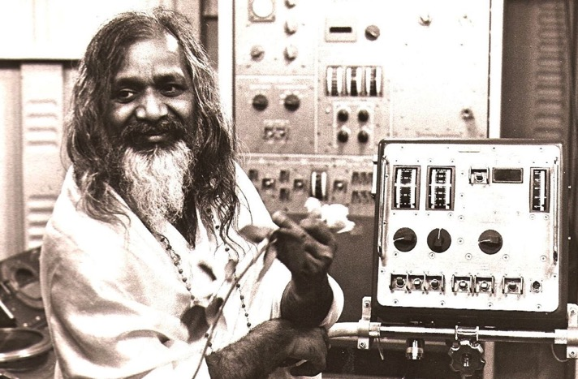
Science and Technology of Consciousness
A Scientific Meditation?
Notes:
Almost from the beginning, Maharishi Mahesh Yogi, the founder of both TM, and of this university, encouraged scientific research on TM. Maharishi strongly felt that we live in a scientific age – and if the effects of meditation are real, they should be measurable.
To date, there have been 378 peer-reviewed studies that have been published in professional journals after having passed the highest standards of the experts who constitute the review boards of these journals. These studies have verified that the practice of TM has wide-ranging benefits for both the mind and body.
The Science and Technology of Consciousness takes the understanding of meditation from the cloudy realm of mystery into the precise light of science, making what had seemed improbable and impractical now documented and realistic. Maharishi felt it was essential that the full development of every individual be understood as a natural, practical outcome of balancing the activity of daily life with meditating daily – that we shouldn’t be living only a small portion of our potential.

Slide 8
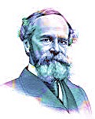
“I have no doubt whatever, that most people live, whether physically, intellectually or morally, in a very restricted circle of their potential being. They make use of a very small portion of their possible consciousness, and of their soul's resources in general, much like a man who, out of his whole bodily organism, should get into a habit of using and moving only his little finger. Great emergencies and crises show us how much greater our vital resources are than we had supposed…. The so-called “normal man” of commerce is a mere extract from the potentially realizable individual whom he represents — and that we all have reservoirs of life to draw upon, of which we do not dream.”
—William James, 1920, p. 252
Notes:
We all have so much potential. This feeling that there are deeper reservoirs within us that we could draw upon has been around for a long time.

Slide 9

Perennial
Philosophy
Notes:
It’s been called the Perennial Philosophy.
“perennial”: Adjective: lasting or existing for a long or apparently infinite time
A perennial plant is one that comes back year after year
The “perennial philosophy” refers to ideas or principles that occur repeatedly. They are seen over and over again.
These principles are not limited to one single point in time or one geographical location. They can be found throughout history, and throughout the world.

Slide 10
What are these principles that many traditions have in common?
At the basis of the extraordinary diversity of the universe is a field of unity, in which everything has its being and apart from which nothing could exist.
Human beings are capable of experiencing this underlying transcendental reality directly, deep within themselves.
The purpose of life is to discover and experience this ultimate reality, to reconnect with the underlying essence of life. To do so is to realize one’s true nature, and to transform and fulfill one’s life.
– Craig Pearson in The Supreme Awakening
Notes:
These 3 ideas are found over and over again throughout history. However, this Perennial Philosophy has been perennially unfulfilled. This was the Ancient Greek philosopher, Heraclitus’s regret. He called this underlying essence of life, Logos, a transcendental, universal law, but even though he knew it was universal, he saw that people rarely experienced or benefited from it…

Slide 11
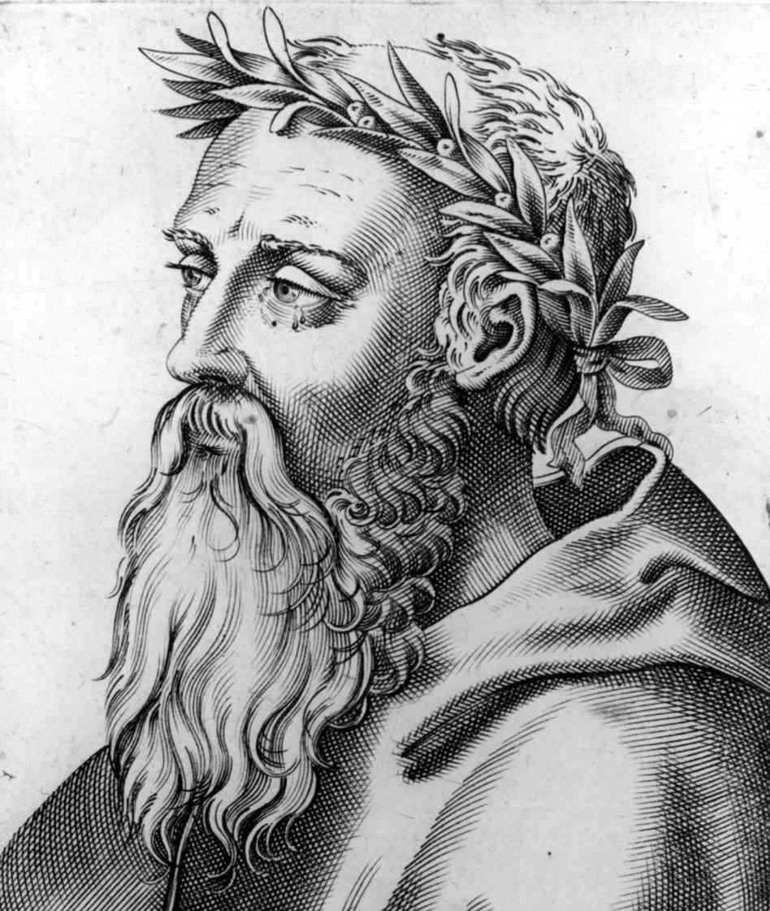
“Although this Logos is eternally valid, yet men are unable to understand it…although all things come to pass in accordance with this Logos, men
seem to be quite without any experience of it (fr. 1).
Although intimately connected with the Logos, men keep setting themselves against it.”
(Heraclitus, fr. 64)

Slide 12
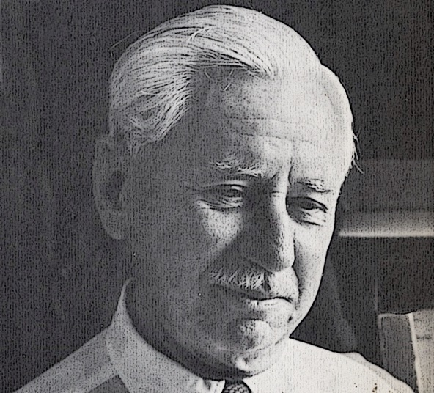
“How can this feeble brain, that aches at a little calculus, ever hope to understand the complex immensity of which it is so transitory a fragment? Not that the intellect is useless; it has its modest place, and serves us well when it deals with relations and things; but how it falters before the eternal, the infinite, or the elementally real! In the presence of that silent reality which supports all appearances, and wells up in all consciousness, we need some other organ of perception and understanding than these senses and this reason.” (Will Durant, 1935)
Notes:
despite the disappointment of not knowing how to find it, the perennial need for the experience of this transcendental state remains through the centuries. It remains in our collective memory; a deep need to know the ultimate reality and our relationship to it.

Slide 13
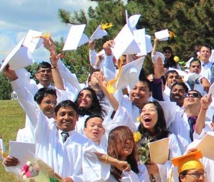


Inner and Outer Fulfillment
Notes:
But this is one of the founding goals of MIU: To develop the full potential of every student by realizing the full range of our existence – from our surface expressions to our transcendental reality, making progress in fulfilling the Perennial Philosophy’s ideal of discovering and experiencing our ultimate reality, and reconnecting with the underlying essence of life. This is realizing one’s true nature, which can transform and fulfill one’s life.

Slide 14
“The first duty is to make use of the possession of this beautiful
instrument that we have.
Develop it fully.
Make use of it fully.”
—Maharishi (1971)

Slide 15

Knowledge of the Knower
as the Basis of all Knowing
Expanding the
Container of Knowledge
Notes:
So at MIU we start with the knower.
We expand the container of knowledge, so that we can more easily and comfortably learn and grow, fitting more knowledge and more understanding in our ever expanding container.
One of the ways we understand ourselves in a more expanded way is to see ourselves as a part of nature. Maharishi outlined 16 principles that exist throughout creation

Slide 16
16 Principles of Creative Intelligence
Universal Principles in nature
Notes:
these 16 principles give us an overview of what we’ll be learning in this course.
Recognizing these principles around us and within us helps us to understand the nature of life at deeper levels.

Slide 17

We are a part of nature. These 16 principles are a part of us.
We are a part of nature.
These 16 principles are a part of us.
Notes:
They’re seen in nature, and in our own thoughts and actions, unifying our inner and outer worlds, and showing us how to function more in harmony with nature’s functioning.

Slide 18

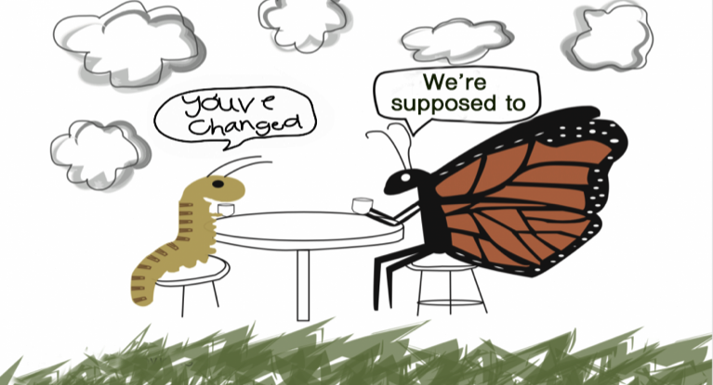



1. The Nature of Life is to Grow
1. The Nature of Life is to Grow
Notes:
Progress, evolution, and growth are the nature of life. The universe is expanding. Plants and children grow, economies grow. For a business or an individual to survive and thrive, it must always progress.
‘We’re supposed to be growing’.
It’s most people’s experience that if they’re not growing they’re uncomfortable, they feel like they’re stagnating.

Slide 19
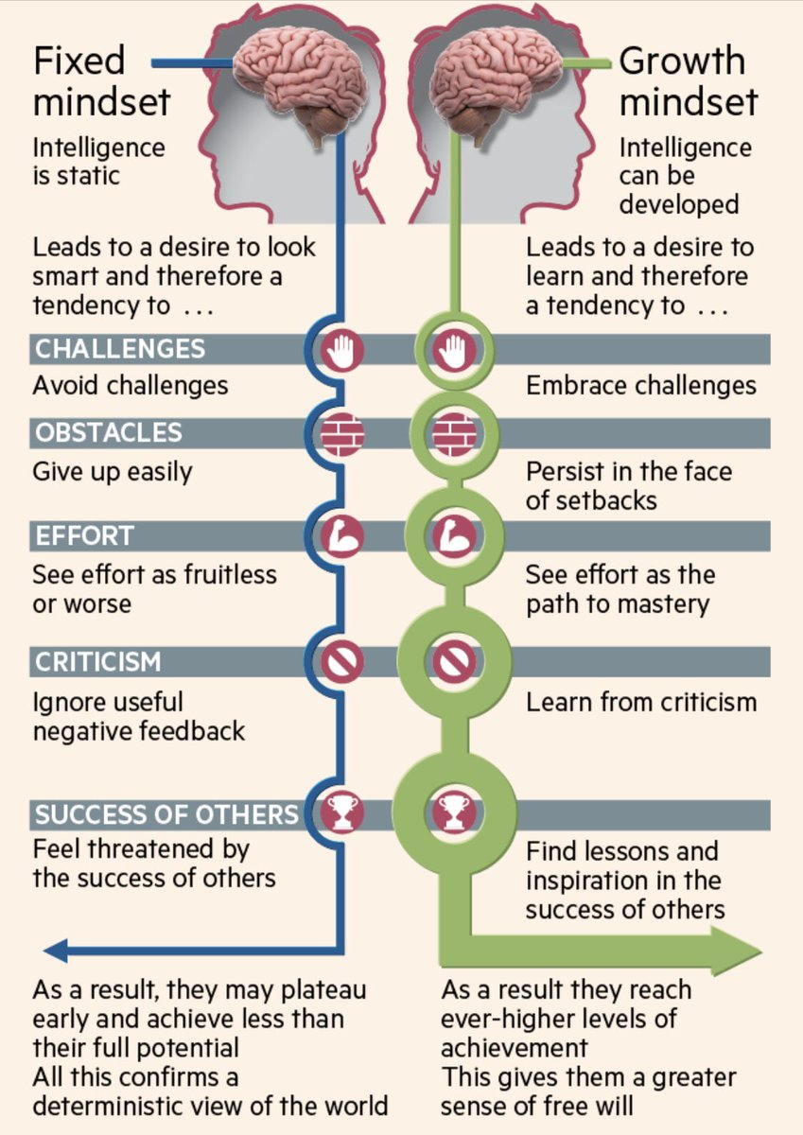
1. The Nature of Life is to Grow
Notes:
Recent advances in neuroscience have shown us that the brain is far more malleable or flexible than we ever knew. It can grow and change. With practice and experience, neural networks grow new connections, strengthen existing ones, and build insulation that speeds transmission of impulses. These discoveries have shown us that We can increase our neural growth by the actions we take – basic actions such as using good strategies, asking questions, practicing and honing our skills, and following good nutrition and sleep habits. These can all change our brain so that we keep growing. TM will also help you continue to grow, as it’s shown to increase creativity and fluid intelligence.

Slide 20
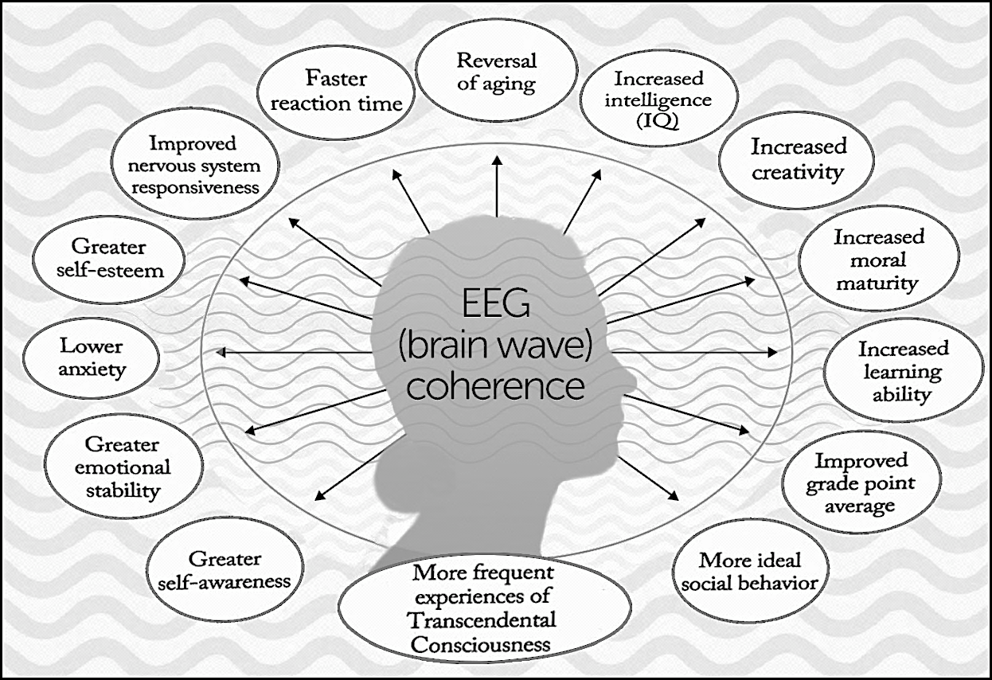
1. The Nature of Life is to Grow
Notes:
The brain wave coherence produced by Transcendental Meditation has been positively correlated with cognitive improvements such as… Increased intelligence, increased moral maturity, increased learning ability, faster reaction time, more ideal social behavior, greater self awareness, self-esteem, and emotional stability. This allows one to continue growing throught life.

Slide 21
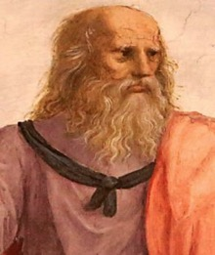
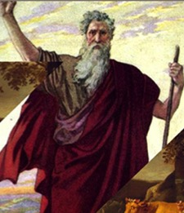
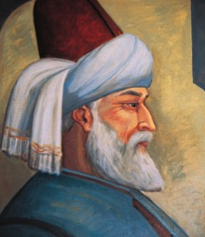

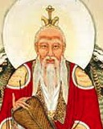

2. Order is Present Everywhere
In ancient Greece, Heraclites found the transcendental source of order in what he called Logos, Plato found it in the Good, and Aristotle in Being. In the Old Testament of Judaism, “Wisdom” or Ein Sof is the origin
of all order. Christianity finds this universal order in the Word; to Thomas Aquinas it was Natural Law. In Islam, Sufi’s refer to it as Ma'rifah, the mystical, direct knowledge of order and truth. In Taoism, the natural, underlying order is in the Tao.
Notes:
In ancient philosophical and religious traditions, there was believed to be a universal order underlying all creation. Again, this is that Perennial Philosophy

Slide 22
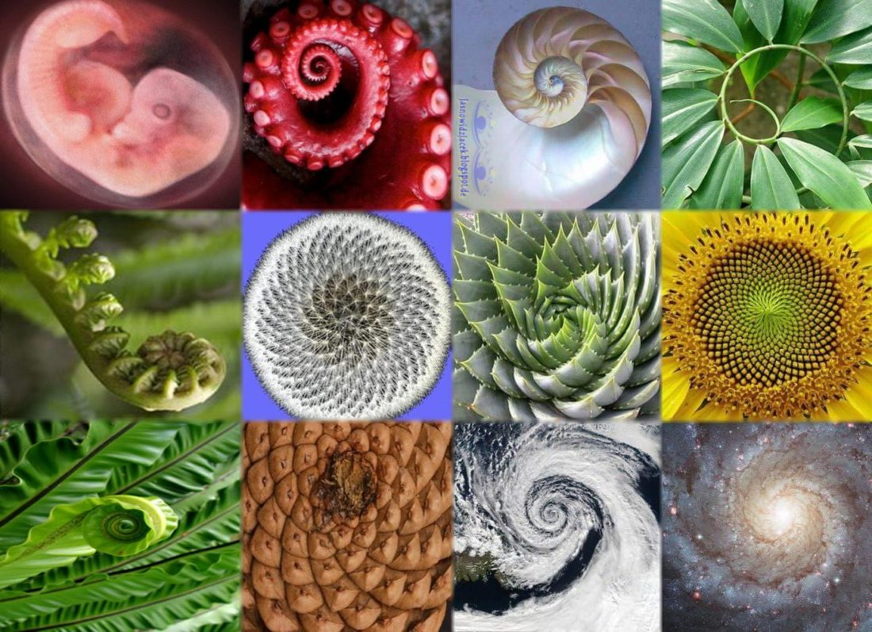
2. Order is Present Everywhere
Notes:
According to physics, the unified field of all the laws of nature is theorized to be a field of perfect order. The laws of nature that give rise to the universe are unchanging and consistent throughout time and space.
Even in Chaos Theory it’s stated that within the apparent randomness of chaotic complex systems, there are underlying patterns, interconnectedness, and self-organization.
The scientist finds the order in chaos through data – organizing data shows deeper patterns, relationships, and unity beneath the diversity.
In the final analysis, nothing is random – order and harmony prevail.

Slide 23
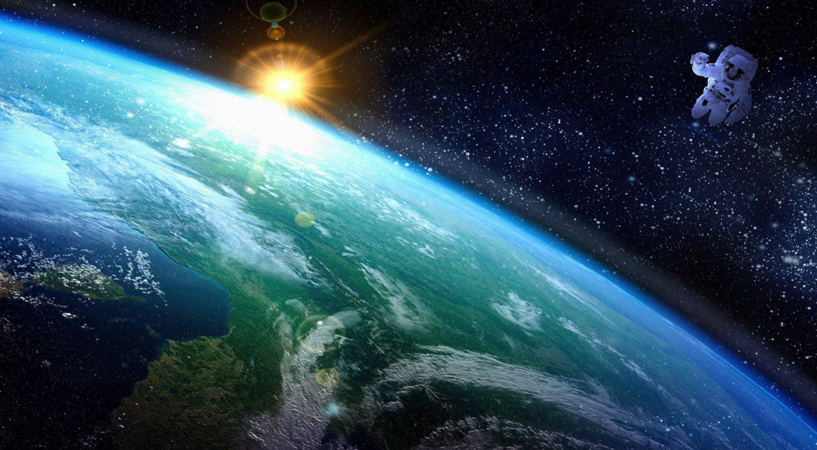
2. Order is Present Everywhere
Notes:
But to see order in everything we sometimes need to experience a new point of view: Sometimes it is a matter of perspective.
The overview effect is a cognitive shift in awareness reported by some astronauts while viewing the Earth from outer space. The boundaries, chaos and conflicts that divide people are diminished by the overall unity and order perceived in the planet as a whole.
This experience was felt to be so important to our growth as humans that the European Space Agency wants to give children an overview effect-like experience using virtual reality in order to give them this same cognitive shift in awareness. Researchers at the University of Missouri aimed to reproduce the experience, with an isolation tank, half a ton of Epsom salts, and a waterproof VR headset.
But it is much easier and more natural to find this same perspective by going in the other direction. Instead of exploring outer space we can explore our own inner space and find the universal field of perfect order and silence within. This can come with any experience of awe, being immersed in nature, or transcending through meditation.

Slide 24
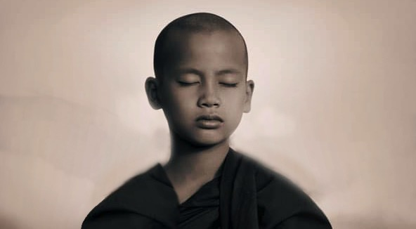
2. Order is Present Everywhere
Notes:
Transcending puts us in the place where all the laws of nature are in their most subtle, unified state – a state of perfect order, and wholeness. Transcending is a very efficient means to bring order and wholeness to life. It’s all there.

Slide 25
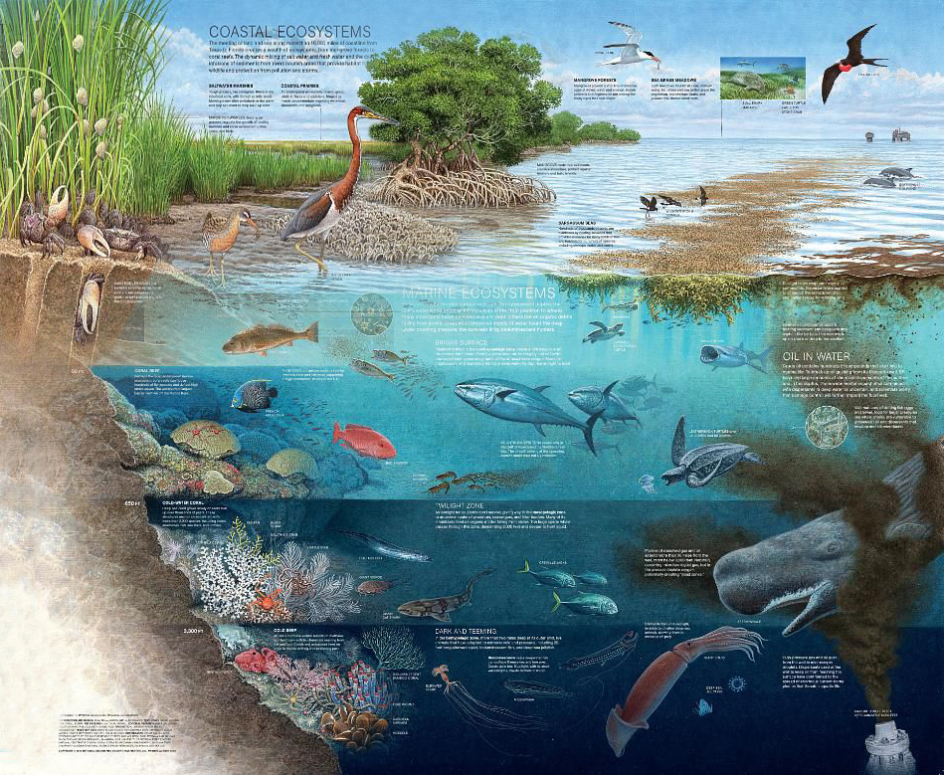
3. Life is Found in Layers
Notes:
Looking deeper gives us a richer understanding of the world around us.

Slide 26
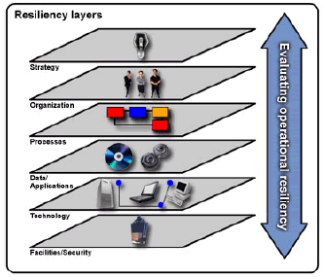
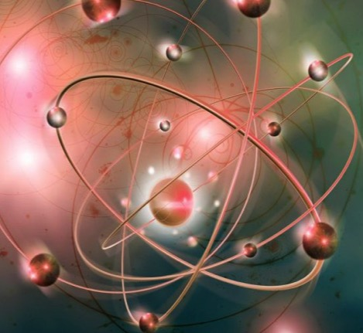
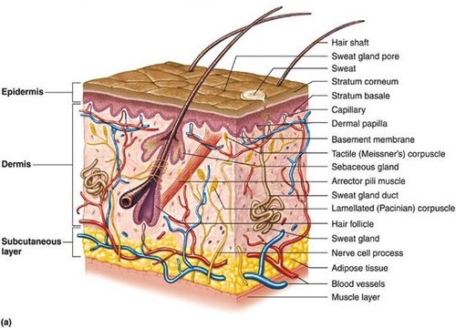
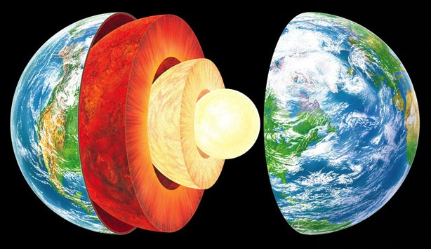
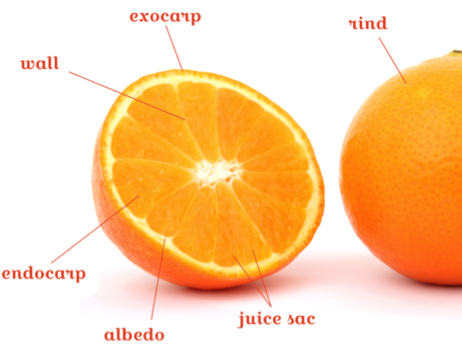
3. Life is Found in Layers
Notes:
Every time we look deeper new knowledge comes out. About the layers of our own physiologies, the earth – An orange has bitter skin on the outside, tasty fruit on the inside, and sweet juice within the fruit. If we looked no deeper than the bitter skin we would never know the sweetness inside.
Physics tells us that creation is structured in layers– surface, molecular, atomic, subatomic, nuclear, subnuclear, and ultimately the unified Field at the basis of all forms and phenomena.
A business can be viewed on the surface — like the day to day operations;
And at its depth – the underlying vision or mission;
or anywhere in between – people, systems, strategies, and tactics.
All layers of a business need to be nurtured.

Slide 27




3. Our Life is Found in Layers
Action and Speech
Thinking
Intuition and Feeling
Transcendental
Notes:
All of this is who we are. We want to know ourselves completely, to be a whole person. In time, TM helps to open up all the layers that make us who we are. Then life is richer and fuller.
Being able to make use of these levels of ourselves can be very helpful in fife –
There are usually 3 stages in the development of any new idea:
1. There’s a moment of Inspiration or intuition that seems to spring from the deepest levels of our consciousness, the transcendental level.
2. After we get a big idea then we think intellectually about the consequences of building on that idea. We look at it logically. If the idea passes that test then…
3. We act on it, we create a model, design, plan. We test it.
the best, newest, most innovative ideas start at the deepest levels.

Slide 28
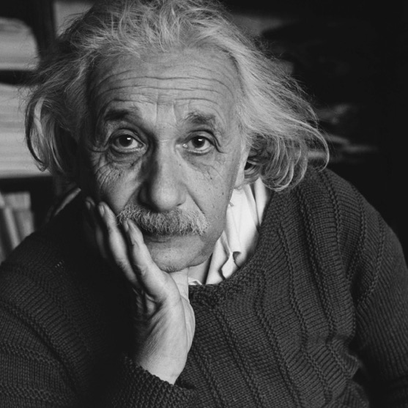
3. Life is Found in Layers
“Indeed, it is not intellect, but intuition which advances humanity” – Albert Einstein
Einstein explained that intuition springs from a connection to the cosmic [transcendental] experience, and asserted, “that the cosmic experience is the strongest and noblest driving force behind scientific research”.
Notes:
We are discovering new technologies and solving our problems by going to deeper levels- think of what we are accomplishing with computer science.

Slide 29
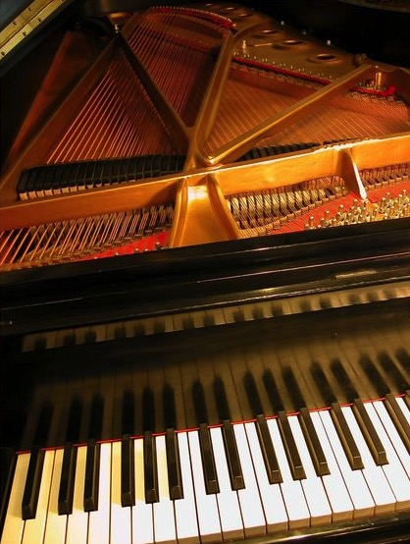

4. Outer Depends on Inner
Notes:
The tuning of the strings inside a piano determine the beauty of the song.
A tall building’s stability depends on what you don’t see — it’s inner structure and a deep foundation.
The outer success of a business depends on how well it fulfills its underlying vision, mission, and values.
How well rested and fresh we are determines our action and success in life.

Slide 30

5. Seek the Highest First
Notes:
An analogy: If we want to accomplish something, the quickest way will be to make friends with the President, and then all of his ministers and assistants will help you.
—When we experience the transcendent where all the laws of nature reside, then those laws of nature riss up to support all our activity.

Slide 31


5. Seek the Highest First
Notes:
the story of the merchant who didn’t go to the bank before going to the market. Here, the highest first is going to the bank, gathering your resources to you can be successful in the marketplace.
—No matter how busy we are, it will always be wise to take the time to take care of ourselves and meditate so that we bring all the resources we have to every project at work, and to all our family and friends. “We can only give from what we have” – Maharishi.

Slide 32

6. Rest and Activity are the Steps of Progress
Notes:
We live in a time of uncertainties and rapid change. It can be challenging to keep progressing yet maintain balance, to fulfill our goals and desires without accumulating stress and fatigue in the process.
Rest and Activity is a simple principle – One foot must be at rest, to provide the basis for the other foot to move forward.
Examples from nature; The earth balances the activity of summer with the silence of winter, the activity of the day and the rest of the night. Life giving blood circulates through the body due to the rest and activity phases of the pumping heart. Nothing just keeps going without resting.
A business progresses through the natural cycles of expansion and contraction.
Deeper rest is the basis of more dynamic, more fulfilling activity. Rest comes in many forms; the sleep of night, taking a break from our work, etc., the traditional day of rest each week in most societies. TM is an effective way to experience deep rest in a short amount of time, helping us to progress more quickly in life.

Slide 33
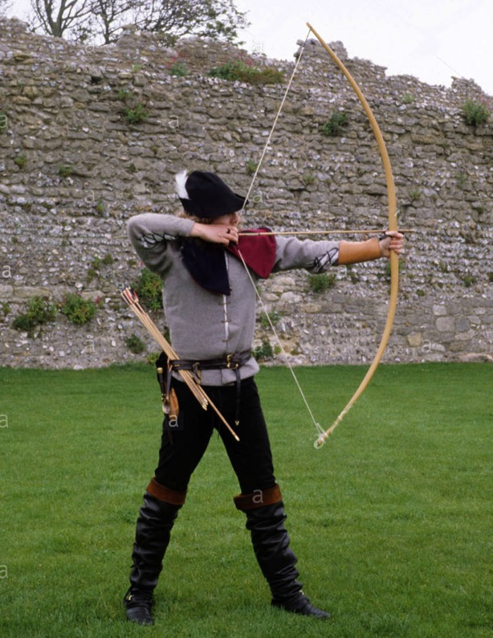

6. Rest and Activity are the Steps of Progress
Notes:
Arrow analogy: To shoot an arrow successfully, it is first necessary to draw it back on the bow. In this state of rest it has great potential energy. When it is brought back to the fullest possible extent, then it possesses the greatest dynamic power and can fly forward to hit the target.
In any creative process, whether programming or writing music, we have moments of rest or silence from where we get the inspiration and energy act on our ideas.

Slide 34
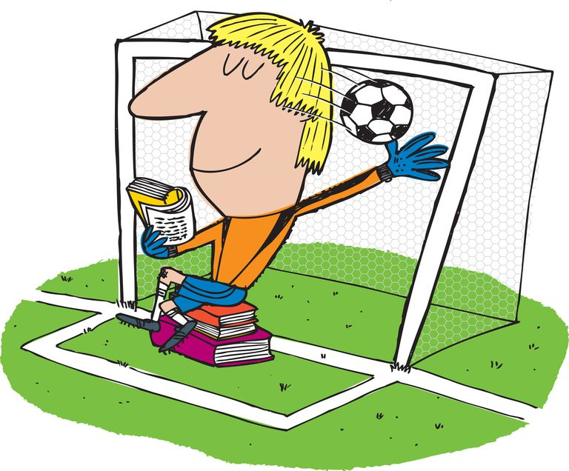
7. Enjoy Greater Efficiency (Do Less) and Accomplish More
Notes:
Nature always operates according to the law of least action. Max Planck, one of the fathers of quantum physics, felt this principle of least action was the most important law in physics
A business continually refines its systems by doing things better with fewer resources.
With a deeper reservoir of energy, intelligence and creativity to draw from, we become more efficient and productive….

Slide 35
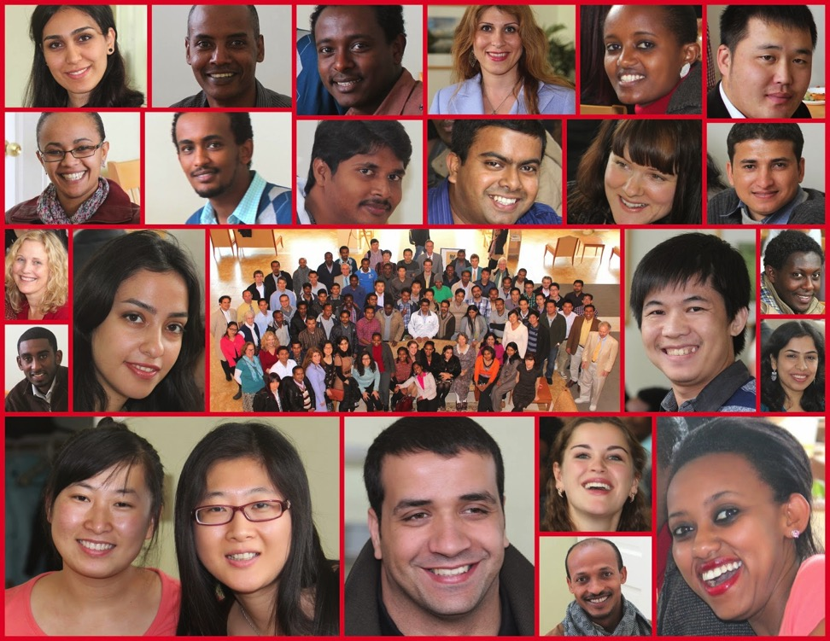
7. Enjoy Greater Efficiency (Do Less) and Accomplish More
Notes:
…and have time to enjoy our achievements — and also have time to enjoy our family and friends.

Slide 36
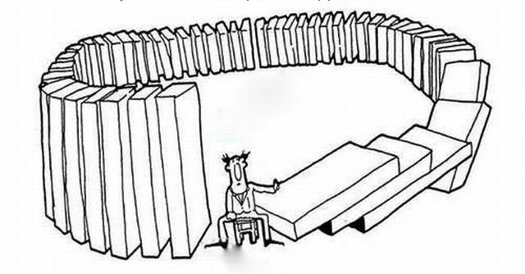
8. Every Action has a Reaction
Notes:
if only we could always remember – What goes around, comes around!
It’s not always easy to know what reaction will come from any particular action that we do, so it’s helpful to align ourselves with natural law at its source, so we are more capable to perform action which is right, and will bring a good reaction to us!

Slide 37
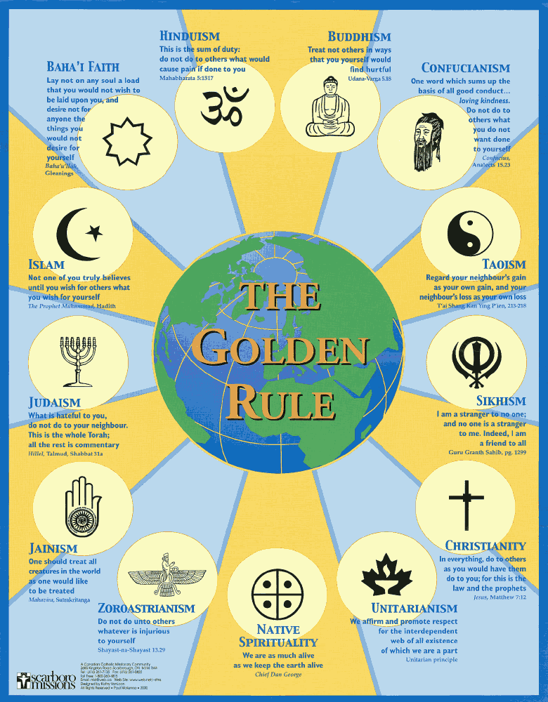
8. Every
Action
has a
Reaction
Notes:
This goes along with what every religion and philosophy states – “Do unto others as you would have them do unto you.” Always be a force for good in the world, and it will come back to you.

Slide 38
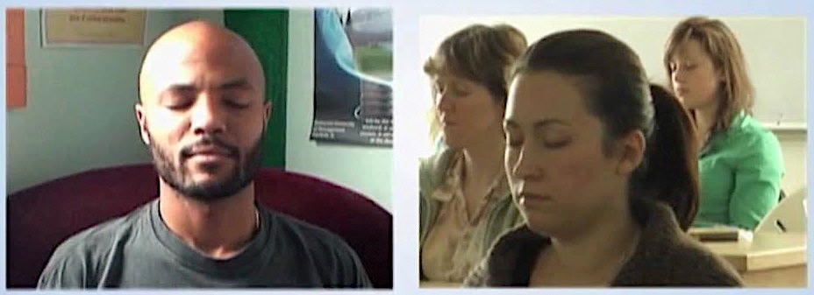
9. Purification Leads to Progress
Notes:
Purification happens during meditation. As a by-product of the transcending process, TM releases stress and purifies our nervous system in a very natural way.
Stress inhibits our progress in life and carries both physical and mental risks. The body naturally wants to get rid of stress. If there is stress in the mind and body it has to be released in order for us to become free of that which is not really us. Stress inhibits us from living our full potential.
The purification of these stresses leads us to more and more progress, happiness and fulfillment in our life.

Slide 39

9. Purification Leads to Progress
Notes:
Analogy: snow plow or shovel – the way must be cleared before we can advance. Otherwise, we aren’t going anywhere!

Slide 40

9. Purification leads to progress
Notes:
But once the way is cleared we can move ahead, free of the obstacles that blocked our way. Free to progress!

Slide 41
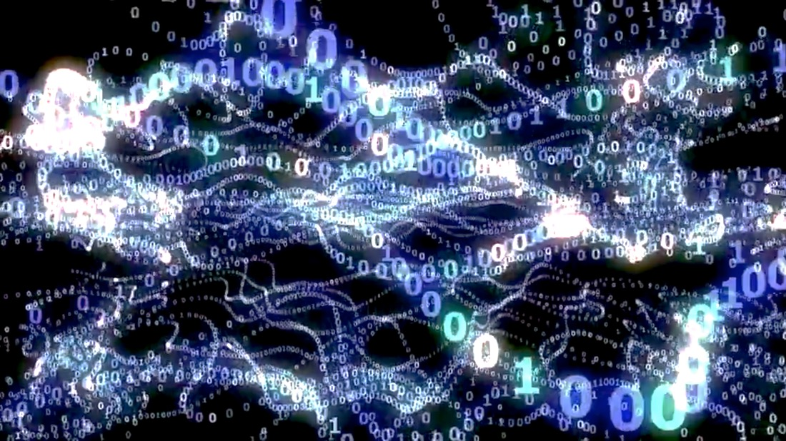
10. The Field of all Possibilities is the Source of all Solutions
Notes:
Dr Hagelin – “The unified field and Transcendental Consciousness share fundamental qualities. Both are unbounded, infinitely dynamic, self-interacting fields of pure intelligence”
STC states that TC is the home of natural law, the field of all possibilities. Quantum physics states that the unified field is the source of all the laws of nature, the unification of all the force and matter fields that become the manifest reality.
This field of pure intelligence, being the source of everything, also contains the solution to everything.

Slide 42
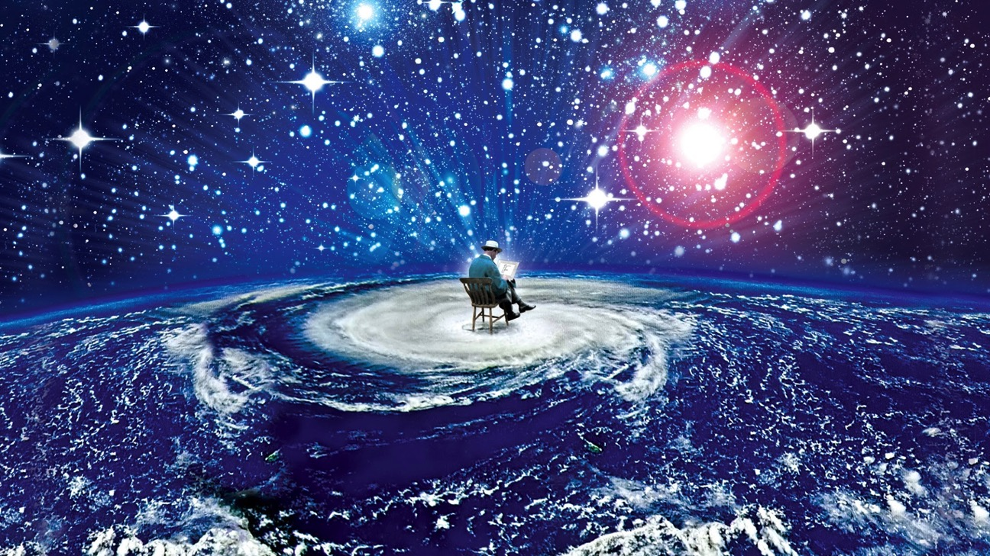
10. The Field of all Possibilities is the Source of all Solutions
Notes:
Dr. Pearson: “The unified field is not down deep somewhere, not out in space, not far away. It is all-pervading. Everything is made out of that. Everything is only a fluctuation of that, is nothing but consciousness.” This is the field of Transcendental Consciousness that is within every human being. Tapping into this field allows us to tap into this source of all solutions.

Slide 43

11. Being is the Basis of Thought, Thought Leads to Action, Action Leads to Achievement, Achievement Leads to Fulfillment.
Notes:
Being, Transcendental Consciousness, is the basis, the foundation for everything else. It is the unchanging field that supports all change and growth in life. But since it is unseen, it is often forgotten…

Slide 44
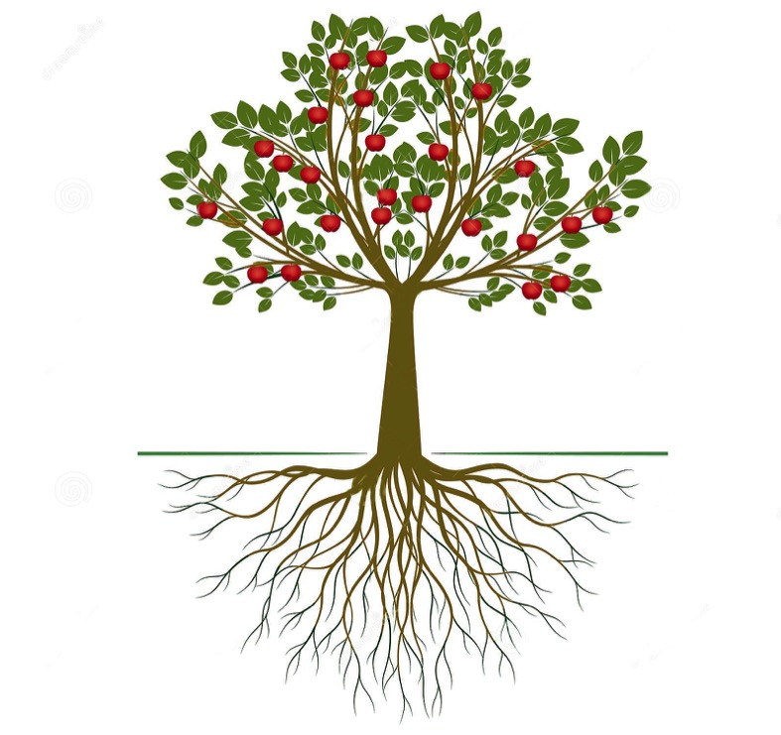
11. Being is the Basis of Thought, Thought Leads to Action, Action Leads to Achievement, Achievement Leads to Fulfillment.
Notes:
It is essential to give attention to the unseen roots of a tree – it’s by watering the root, that every aspect of the tree flourishes.

Slide 45


12. Knowledge is gained from inside and outside
Notes:
Knowledge comes from information coming through our senses about the outside world, it also comes from deep within, from the level of intuition and the transcendent.

Slide 46
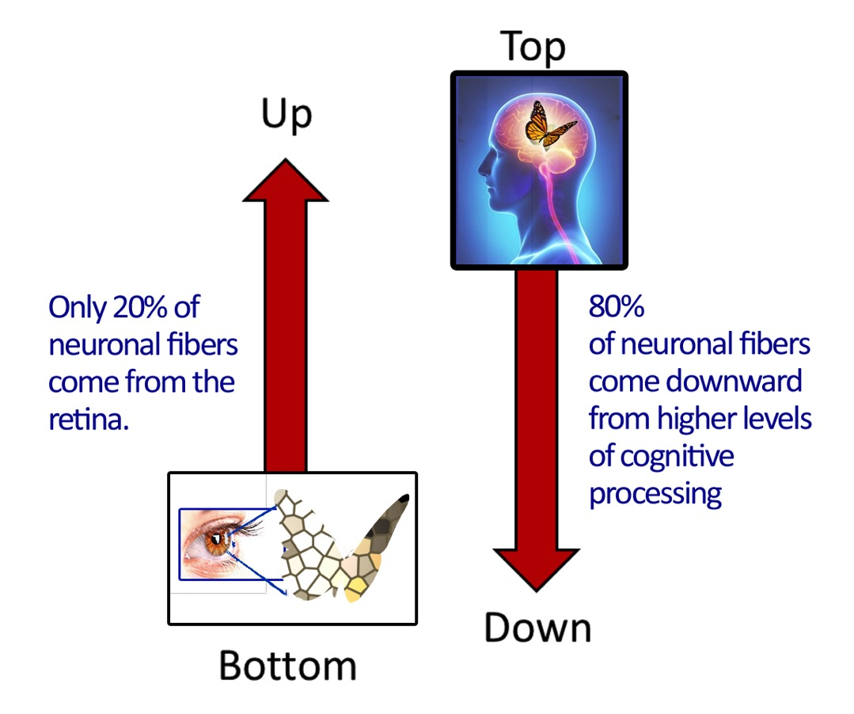
12. Knowledge is gained from inside and outside
Notes:
Research in the last decade is emphasizing the role of memory in providing the right information to produce optimal human behavior. Experience encourages us to think of perception through the senses as providing us with an accurate picture of the external world. However, leading British neuropsychologist Richard Gregory (2009) and others now believe perception is estimated to consist of 80 to 90% memory with as little as 10% coming from input from the senses about our environment. They believe perception is largely stored knowledge or memory: “Perception is based on ancient, innate, and on more recent learned knowledge from the past, with present information from the senses for real-time behavior” (p. 226).
This is supported by scientific studies of brain-anatomy and visual sensations…
“If visual sensations were primarily received rather than constructed by the brain, you’d expect that most of the neuronal fibers going to the brain’s primary visual cortex would come from the retina. Instead, scientists have found that only 20% do; 80% come downward from regions of the brain governing functions like memory.” (Gawande, 2008)

Slide 47
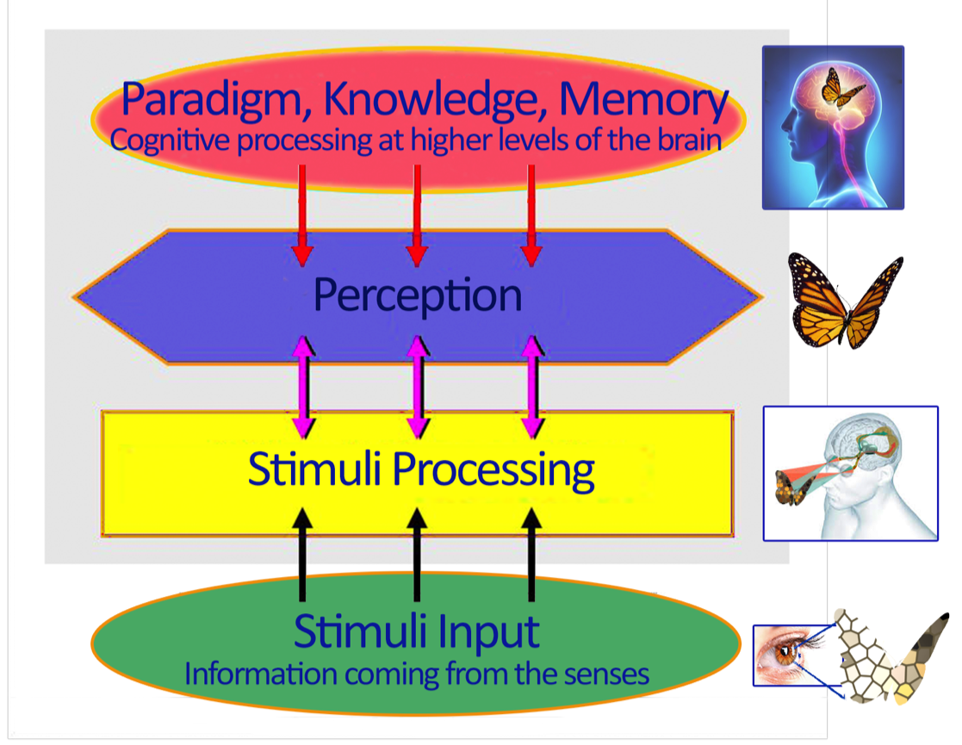
12. Knowledge is gained from inside and outside
Top-Down
and
Bottom-Up
Processing

Slide 48

13. Knowledge is Structured in Consciousness
Notes:
Knowledge is structured in Consciousness
was the original motto of MIU:

Slide 49


13. Knowledge is Structured in Consciousness
Notes:
When we are sleepy and dull nothing seems interesting and it’s difficult to learn. When our consciousness is clear learning is an enjoyable adventure.
The knower is primary. Without the knower, there is no real foundation for knowledge.

Slide 50

13. Knowledge is Structured in Consciousness
Notes:
You’ve heard the saying, ‘The world is as you are’, or ‘We don’t see things are THEY are, we see them as WE are”. If we have a positive outlook, we’ll see the world as a positive place. It all depends on our vision.
Analogy: Green colored glasses makes everything green. How we see changes the way we understand the world. The clearer our consciousness the clearer our understanding of any project we’re working on, or any situation we find ourselves in.

Slide 51


What is a paradigm?
Notes:
A paradigm is the framework that creates the way we see the world. Our cultural, religious, political, or economic status can completely color and determine how we see the world. Even unconsciously, we make judgments every day due to this perspective. These judgments can be unifying or alienating. They can be based on superficial, isolated parts (the materialistic, classical paradigm) – or on a deeper, more holistic picture that comes from a quantum or consciousness based paradigm.
The more expanded our consciousness is,
the clearer perception and understanding will be.
This will provide a strong basis for more appropriate, effective, and fulfilling action.

Slide 52
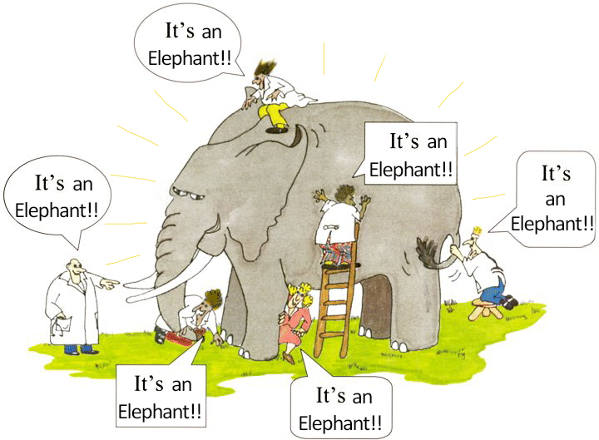

13. Knowledge is Structured in Consciousness
Notes:
Limited knowledge and limited consciousness gives a limited view of the world.
This picture illustrates an old story. Each person here has their vision restricted, and they’re only touching one isolated part of the elephant. They’re all touching the same thing, an elephant, but they only feel a small part, and they mistake that for the whole reality. Human beings can even create conflicts over their chosen perception of reality, and feel everyone else is wrong.

Slide 53
13. Knowledge is Structured in Consciousness
Notes:
Once they can see, the parts are seen in connection with the whole. And they can stop disagreeing! Knowing and appreciating the whole truth is much more useful, exciting, and fulfilling. And it unifies people.

Slide 54
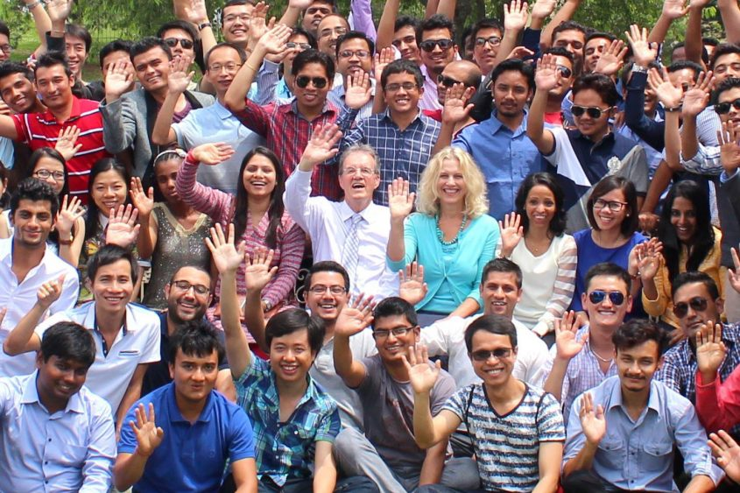
14. Harmony Exists in Diversity
Notes:
When the reality of unity underlies the experience of diversity it creates a harmonizing effect.

Slide 55
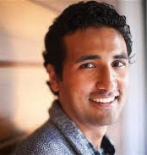



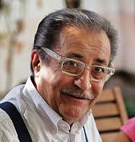




14. Harmony Exists in Diversity
Notes:
Despite the differences separating humankind, in truth we are far more alike than different in almost every way: in our needs, our desires, our ideals, and even our physiology.
An international study at Stanford, indicated that 99.9% of our DNA will match our brother or sister, as well as someone of another race and culture living on the other side of the world (Shwartz, 2003). It will match our future, unborn grandchild as much as a stranger who lived 50,000 years ago. We are all truly so much alike.
That remaining .1% of difference does indeed makes us unique, but it is helpful to remember our collective lineage, our universal values, and the common source of them all.

Slide 56

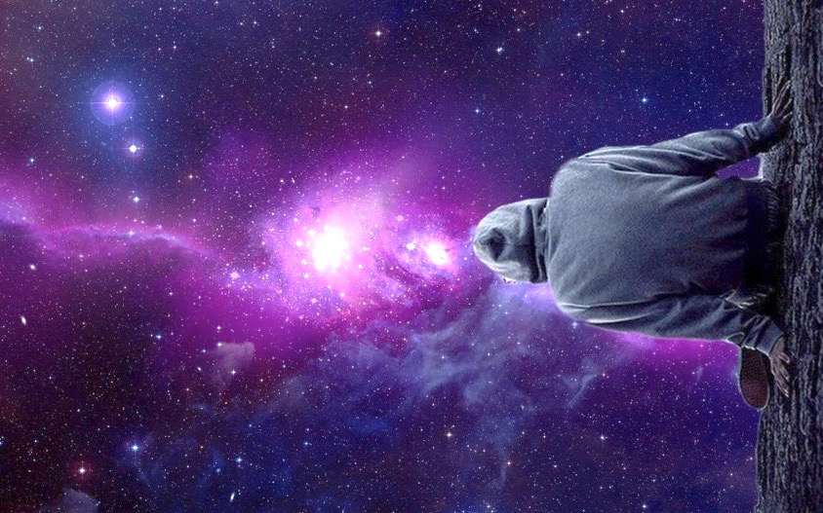

15. The whole is contained in every part
Notes:
Every team member represents the whole team. But every player on a team needs to remember the whole team and move in coordination with them.
Every drop contains the essence of the ocean in it. The drop can’t be separated from the ocean for long or it will dry up.
Every individual consciousness contains the unbounded field of consciousness within them. But it’s up to us to maintain the connection to this wholeness.

Slide 57

16. The Whole is Greater than the Sum of the Parts
Notes:
In the relative sphere of life…we see this when people come together to do great things.

Slide 58
16. The Whole is Greater than the Sum of the Parts
Notes:
And in the deeper sphere of life — Our holistic, unbounded true Self is greater than the sum of all the parts that make up who we are in our day to day life.
Contacting, and living a life based on the field of unity underlying all existence, as expressed in the Perennial Philosophy has not been a common experience. In the 20th century, positive psychologist Abraham Maslow determined that Self-actualization – the achievement of one’s true self – the highest pinnacle of human life, was achieved by less than 1% of adults, and even those who do achieve it may not hold on to it. TM can empower more individuals to achieve this goal.
Growing towards this goal creates authentic well-being which involves deeper levels of a person – and research has now found that it also creates balance in the physiology by causing a decrease in stress-related genes. This greatly impacts our health. On the other hand, Well-being based on self-gratification and simple pleasure seeking does not generate growth either psychologically or physically – and it actually causes an increase in disease promoting genes

Slide 59

16. The Whole is Greater than the Sum of the Parts
Notes:
Scientific studies have indicated that TM may be a useful intervention, or tool, for achieving authentic well-being, better health, and the development of our full potential. This is what we wish for every student at MIU.

